Slide 1

Florida Condo Lending
New Reserve Legislation Impact on Residential Mortgage Lending
Presented by
Orest Tomaselli, Melissa Cohn and Nancy Cardone

Slide 2
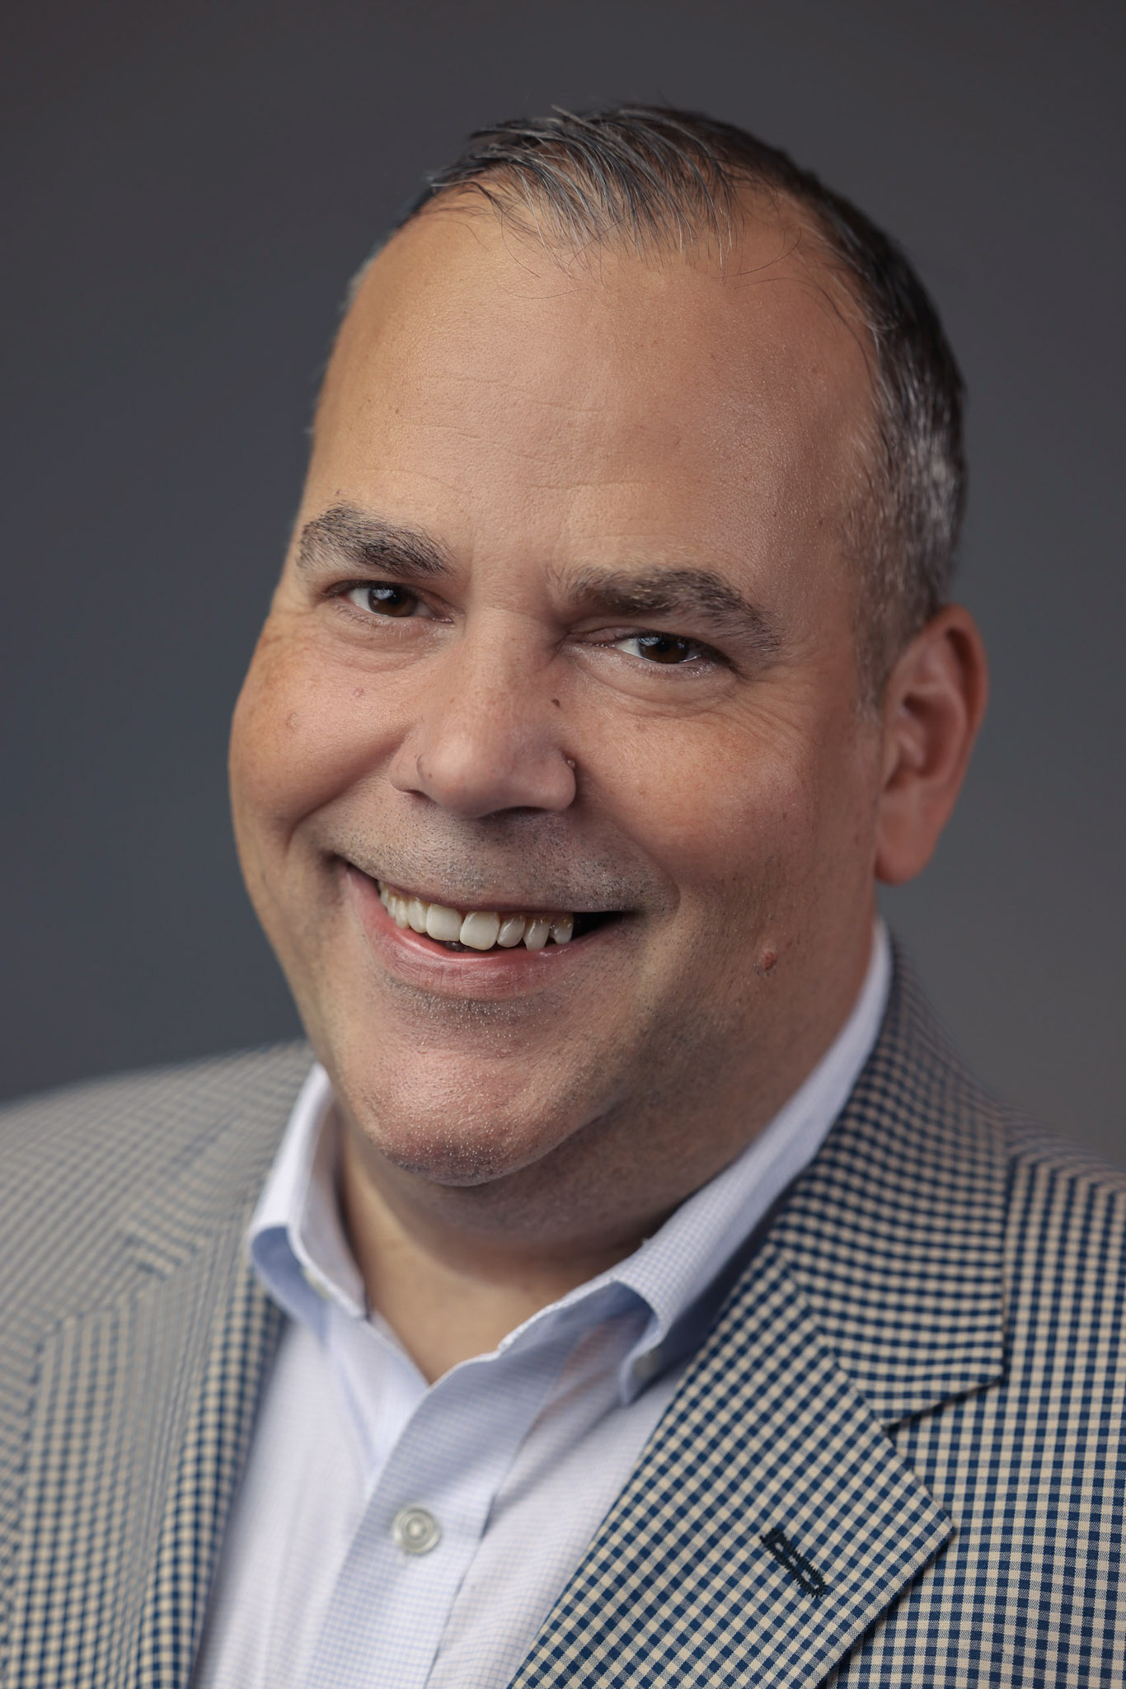

Orest is both the President of the condominium and cooperative Project Review division at CondoTek and the Founder and CEO of Strategic Inspections, a national reserve study provider.
Orest’s name is synonymous with condo and co-op lending compliance. He has provided Fannie Mae, Freddie Mac, FHA, VA and Portfolio lending approvals for thousands of buildings across the United States.
Property developers, managers, lenders, board members and attorneys have relied upon Orest’s expertise to ensure both residential and commercial mortgage availability, provide accurate reserve compliance and ensure building- wide lending approval.

Slide 3

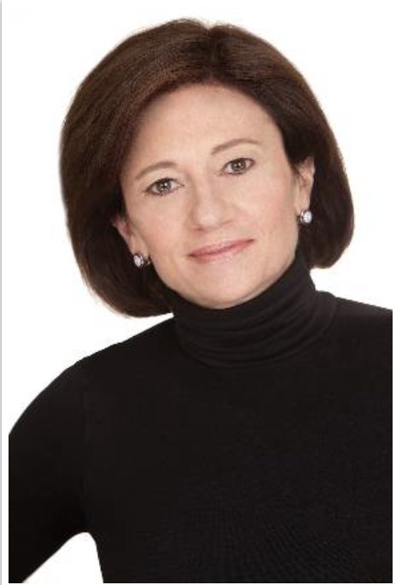
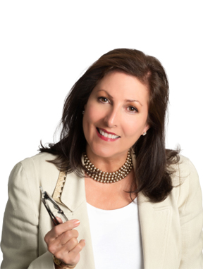
Melissa Cohn, Regional Vice President
William Raveis Mortgage
A pioneer in the mortgage industry for more than 35 years, Melissa Cohn began her career with CitiMortgage before launching her own successful mortgage company, The Manhattan Mortgage Company, in 1985. As one of the very first independent mortgage brokers, Ms. Cohn was able to exponentially grow her business into the #1 residential mortgage broker on the East Coast with more than $5 billion in annual volume. In 2020, she joined William Raveis Mortgage, where she is currently a top originator in the company. Her expertise and insights are regularly featured in press, including The Wall Street Journal, Forbes, Bloomberg, CNBC/Acorns and Mansion Global.
Nancy Cardone, Sales Management, Manager of Strategic Growth
William Raveis Real Estate
A 30+ year veteran of the real estate industry, Nancy Cardone has been involved in active residential sales, development sales, and real estate brokerage management. Nancy's positions at the national, state, and local levels of the Realtor Association keep her abreast of legislative and regulatory changes to the real estate industry affecting agents, brokerages, and consumers. The public policy arena has always held special interest to Nancy, who has run for public office in the past. Currently, Nancy Cardone manages the North Palm Beach and Hobe Sound offices of William Raveis Real Estate.

Slide 4
Florida Reserve Legislation
Milestone and Forensic building inspections for all condominium buildings are required
Mandatory structural integrity reserve study every 10 years to determine the amount of reserves required for future repairs and replacements Required reserve funding for structural integrity components (building, floors, windows, plumbing, electrical, etc.) based on the reserve study.
Removal of the right of condominium association to waive the funding of reserves for structural integrity components.
Mandatory transparency—providing all owners and residents access to building safety information.
Condominiums must conduct a milestone inspection by December 31, 2024.

Slide 5
Surging Insurance Costs for HOA’s
Condominium Association fee Increases Averaging 20-25% in Florida.
2023 Condo Budgets are Already Impacted
Mortgage Qualification Becoming More Difficult
Unit Values In Key Markets are Declining
Limited Access to Conforming Lending

Slide 6
Navigating Lending for Condo Borrowers
Fannie Mae/Freddie Mac
Loan Limit Increase
Unavailable for Lending List
Qualifying Borrowers with Increased Maintenance Costs
Triggering Non-Compliance: Special Assessments, Deferred Maintenance
CONFORMING
JUMBO
PORTFOLIO
NON-QM
NEW CONSTRUCTION

Slide 7
Best Practices for Florida Condo Properties
Determine
Determine Mortgage Availability for Unit Owners and Purchasers
Obtain
Obtain Fannie Mae Building-Wide Global Lending Approval (PERS)
Obtain
Obtain Bank Portfolio Lending Approval
Check
Check the “Unavailable” List Often
Align
Align With Reserve Requirements
Complete
Complete all Deferred Maintenance Repairs

Slide 8
Contact Information
Orest Tomaselli
800-452-4816 x303
Orest@CONDOTEK.COM
Melissa Cohn
917-838-7300
Melissa.Cohn@raveis.com
Nancy Cardone
651-308-9441
Nancy.Cardone@raveis.com

